Slide 1


MAHENDRA ENGINEERING COLLEGE
(AUTONOMOUS)
DEPARTMENT OF COMPUTER SCIENCE & ENGINEERING
WEATHER FORECASTING
Date: 06.10.2023
Prepared By:
KALAISELVAN N (Reg.No.: 211031059)
KABIRAJAN M(Reg.No.: 211031058)
BE – Third Year / V Semester
Guided By:
DR.P.RAMYA
ASSISTANT PROFESSOR
Notes:
Title

Slide 2
Abstract
Weather forecasting is the attempt by meteorologists to predict the weather conditions at some future time and the weather conditions that may be expected.
This project leverages cutting-edge technology and data sources to deliver accurate and up-to-date weather information to users across the world

Slide 3
Proposed system
This project is going to explain the climatic condition parameters are based on the temperature, wind, humidity, rainfall and size of data se.
Advantages of Proposed Systems:
Agricultural Planning
Tourism and Outdoor
Activity Health and Safety

Slide 4
Software Specification
Front End
It is part of the website users can see and interact with such as the graphical user interface and the command line including the design, navigating menus, text, images, icons etc.
Languages used for the front end are HTML,CSS,Java Script.
Back End
It is the sever side of a Website.
It collects data from data from API website and It deliver accurate weather information to the user.
Languages used for the back end for Javascript.

Slide 5
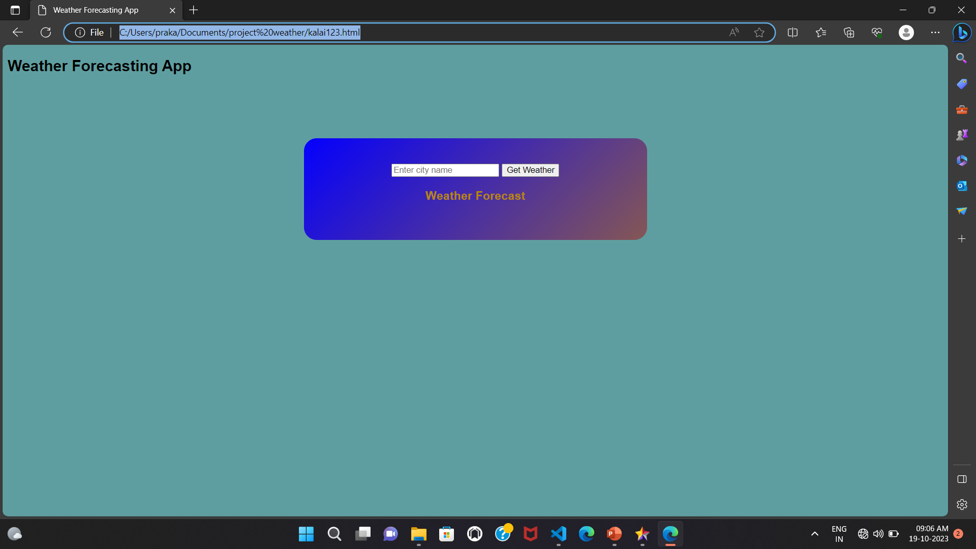
Screen Shots

Slide 6
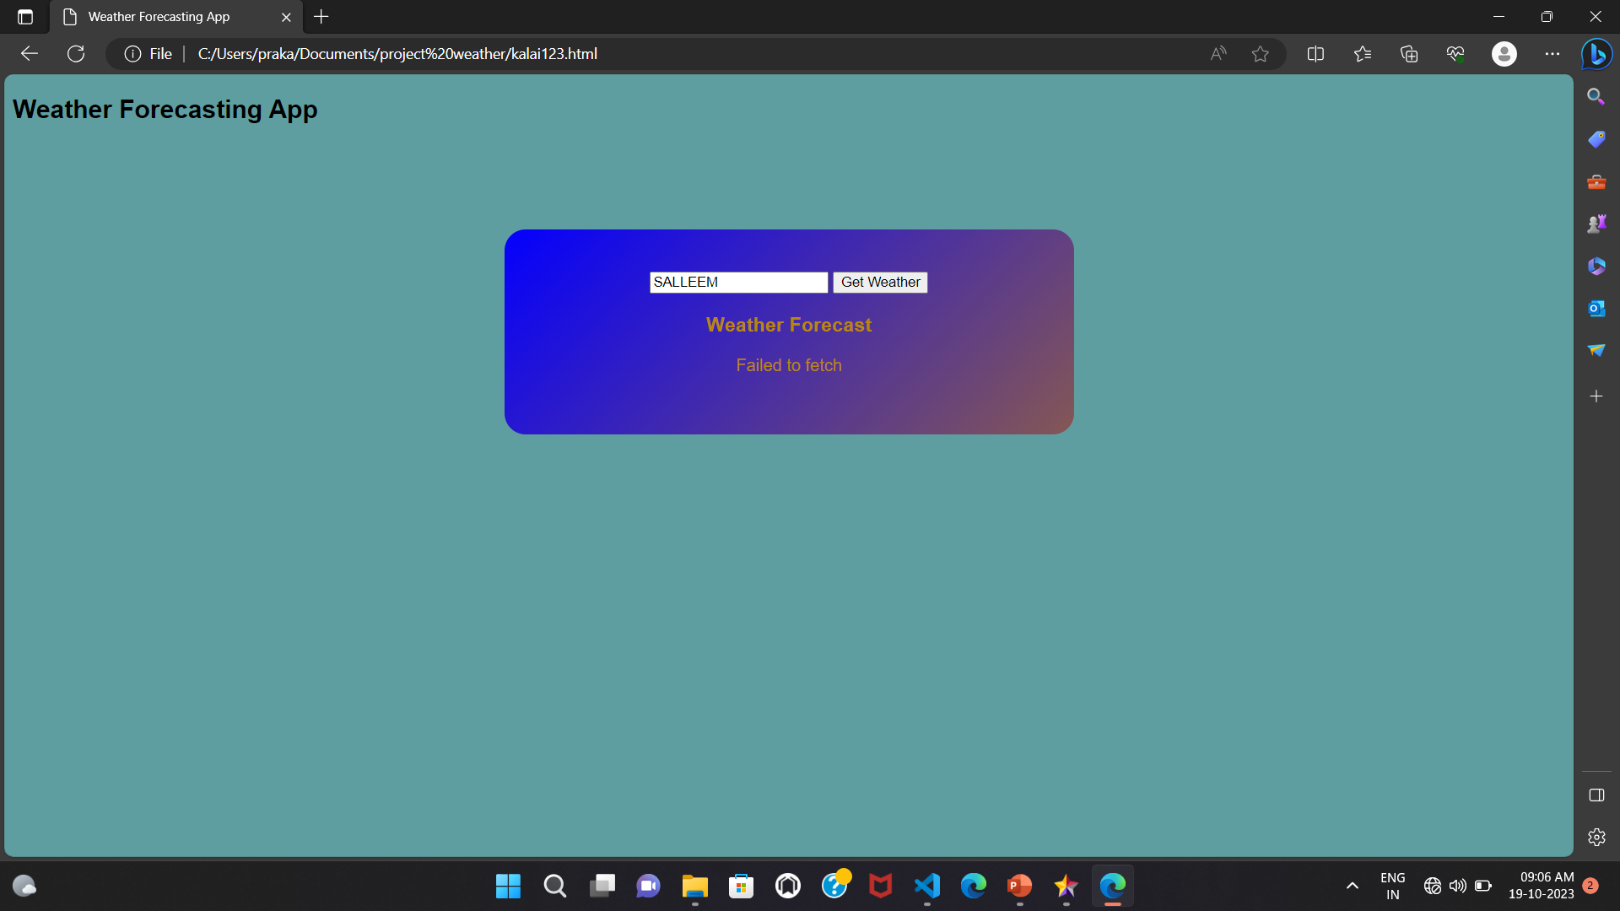

Slide 7
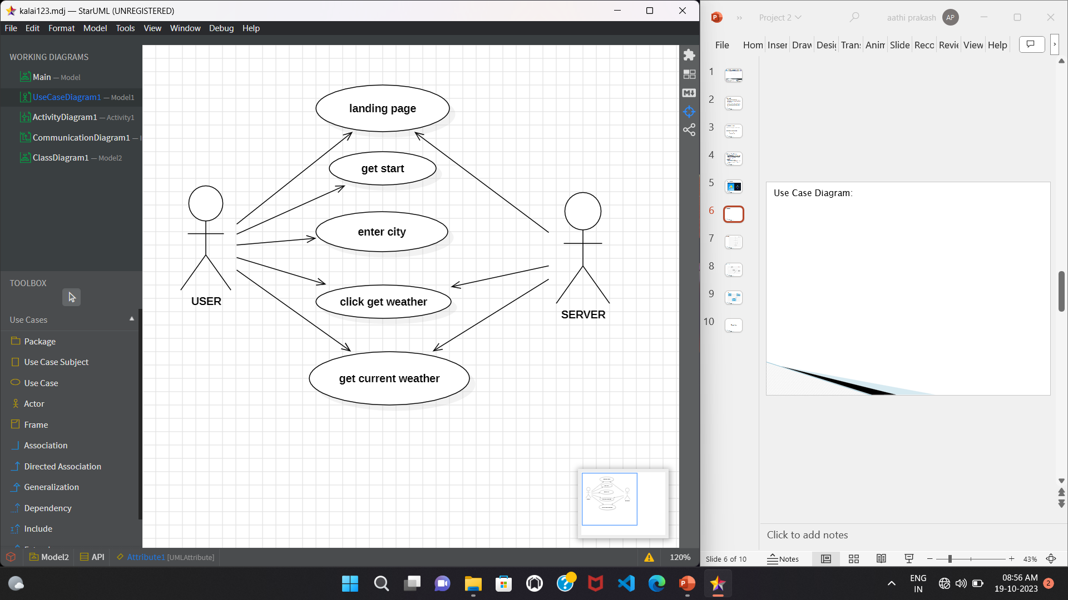
Use Case Diagram:

Slide 8
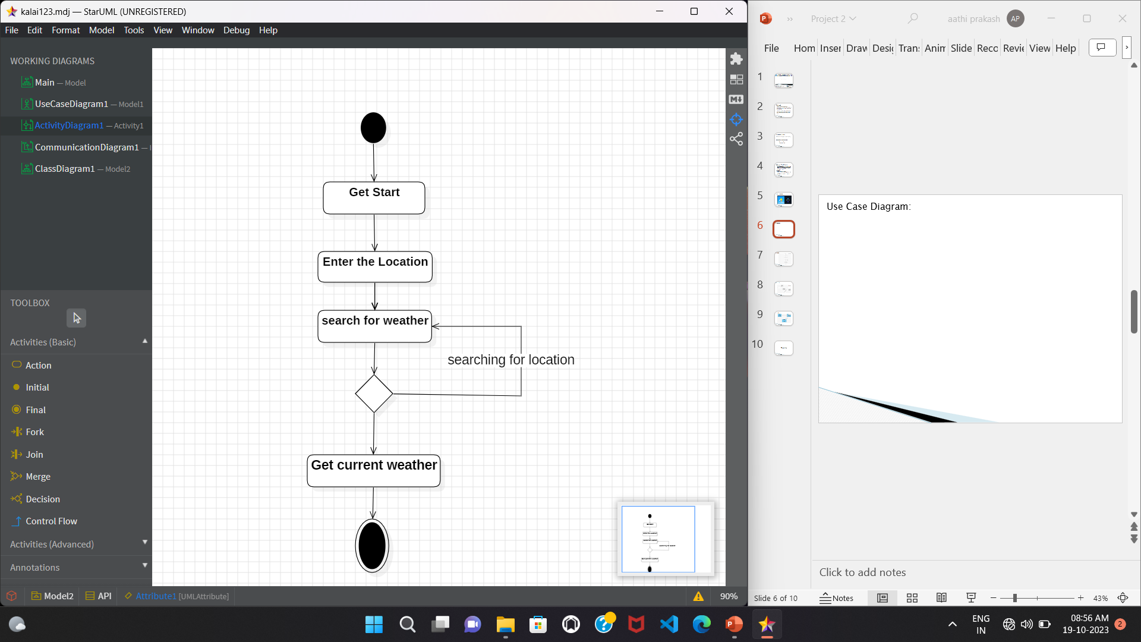
ACTIVITY DIAGRAM

Slide 9
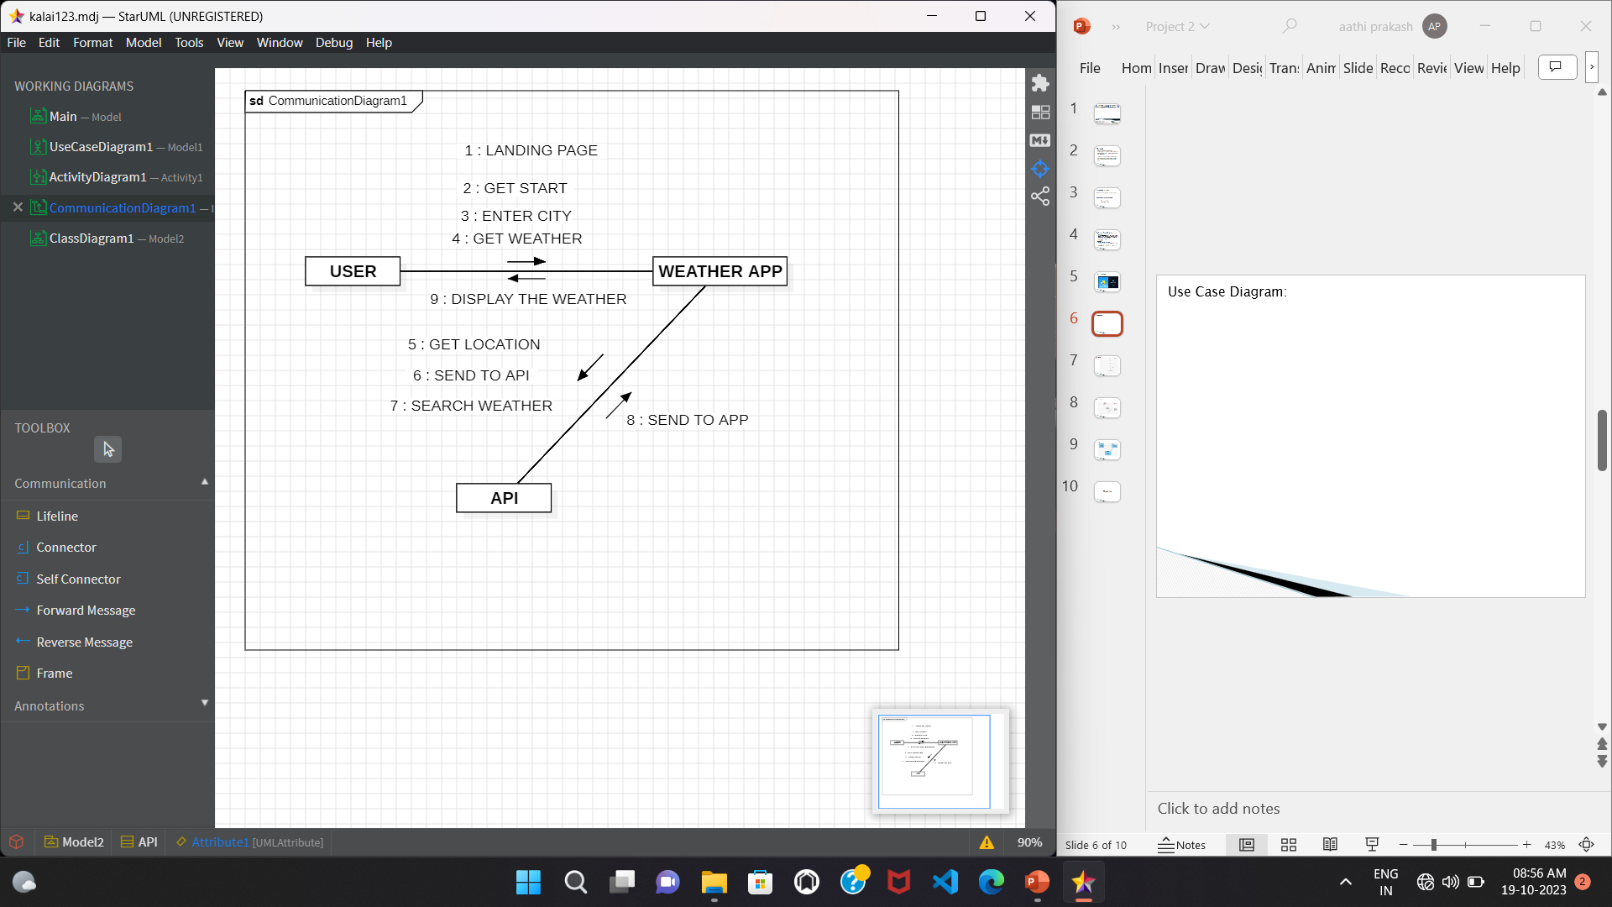
COLLABORATION DIAGRAM:

Slide 10
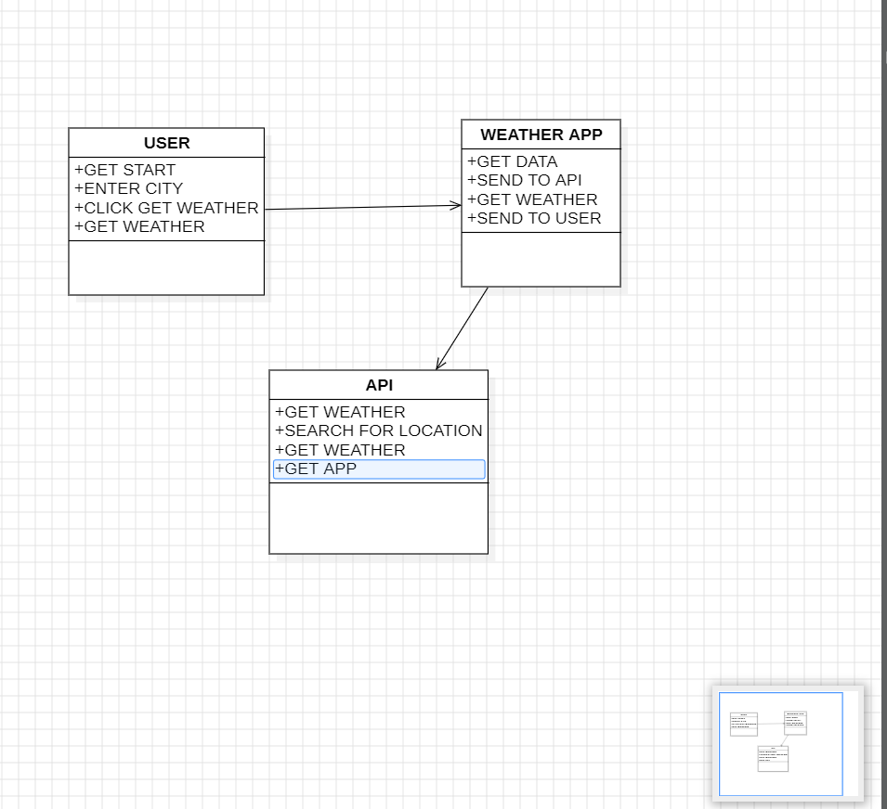
CLASS DIAGRAM

Slide 11
Thank You

